Slide 1

Modelling Crystallization using ML – augmented Molecular Dynamics simulations
Summer Undergraduate Research Award (SURA) 2023
Facilitator Name:
Prof. Tarak Karmakar
Dept. of Chemistry
Team Members:
Harshit Kumar Gautam 2021CS50129
Abhinav Singh 2021CS50746

Slide 2
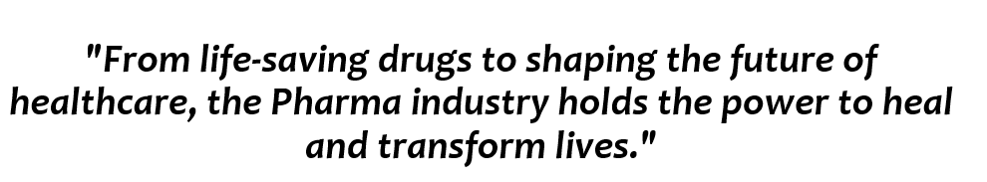
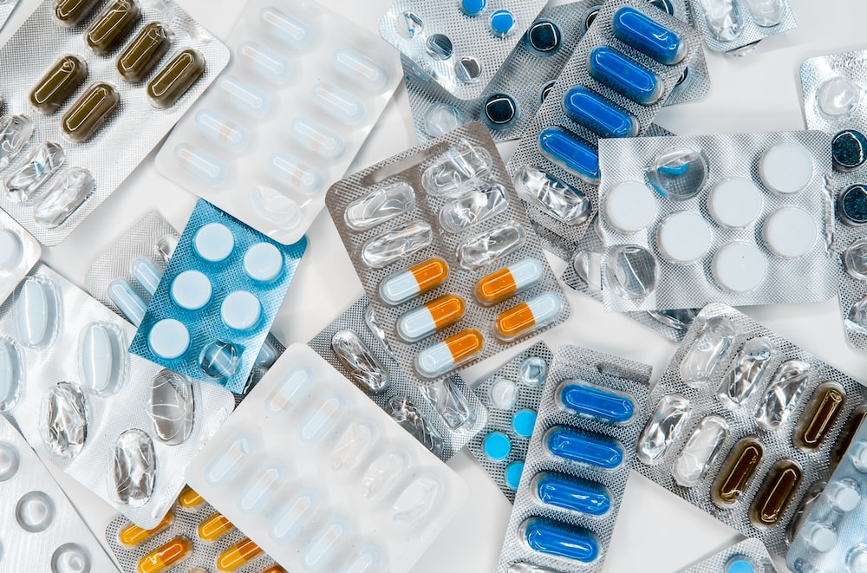
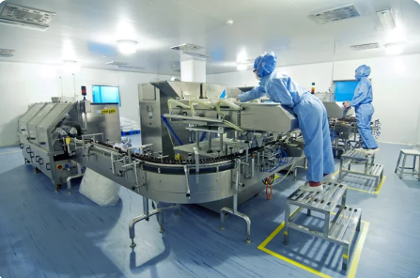
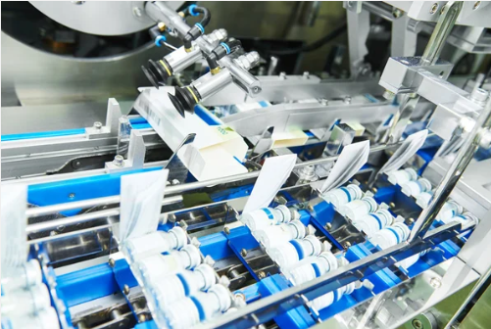
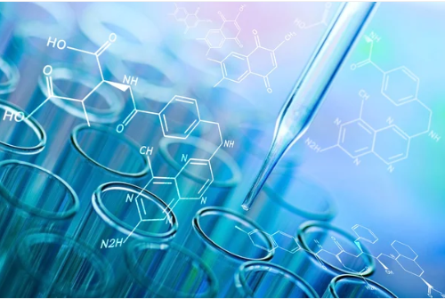
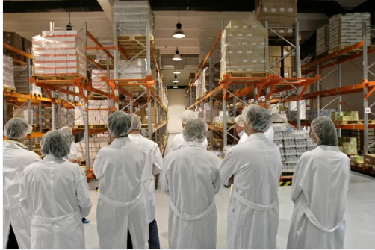
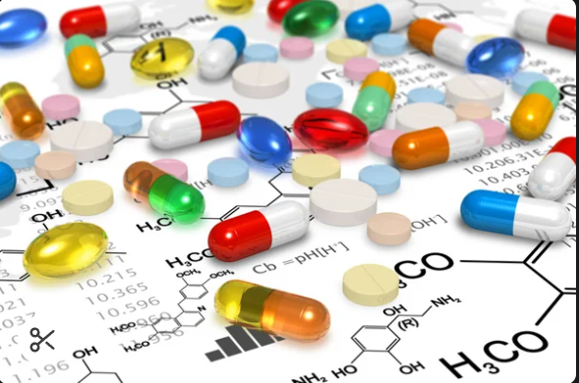
From life-saving drugs to shaping the future of healthcare, the Pharma industry holds the power to heal and transform lives."

Slide 3
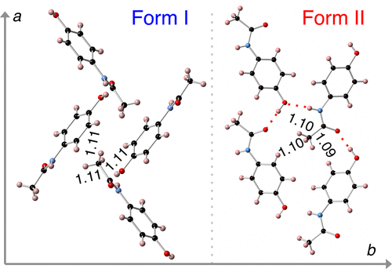
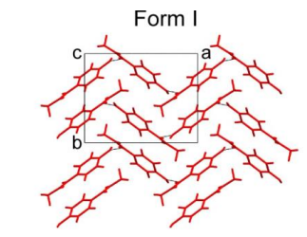
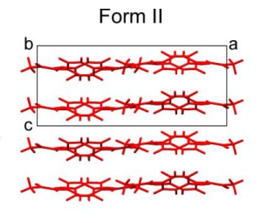
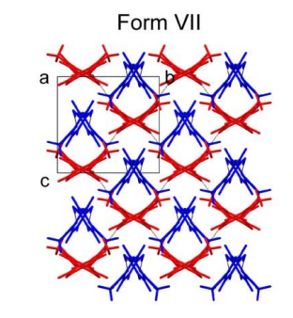
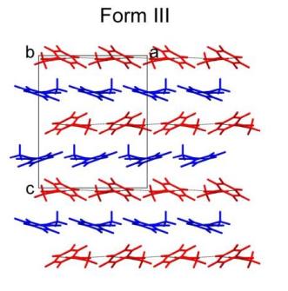
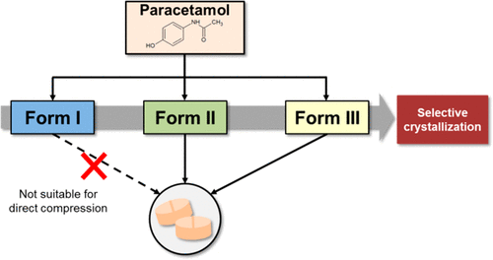
POLYMORPHISM IN PARACETAMOL
SOLID POLYMORPHS
LIQUID POLYMORPHS

Slide 4
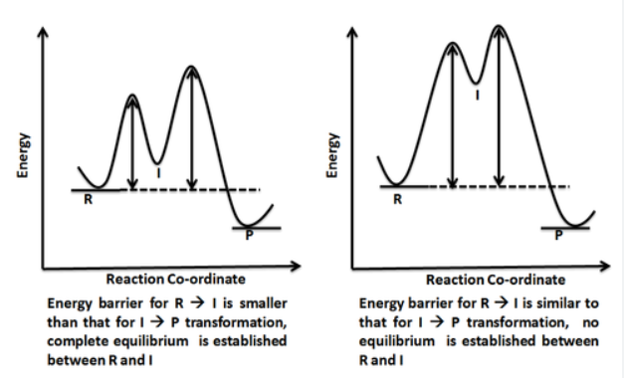
Relative Stability of Different forms
The relative Stability of Different Polymorphs and states is determined through Free Energy Profile Diagram (Energy vs Reaction Co-ordinate)..
Question arises: What should we choose as an ideal Reaction Co-ordinate??

Slide 5
Introduction
This project is about developing machine learning (ML) methods to find out order parameters (OPs) that can distinguish an ordered crystalline state from a disordered liquid state.
These OPs are used in enhanced sampling (advanced molecular dynamics) simulations to sample phase transitions and calculate phase diagrams.
It has relevance in the design of active pharmaceutical ingredients and their relative stability and explore phase diagram.
Our results will help uncover the crystallization mechanism and optimize crystallization conditions relevant to industrial synthesis.

Slide 6
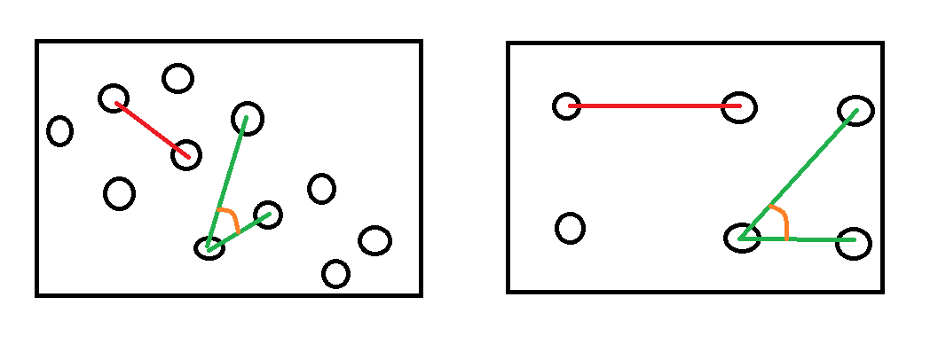
UNDERSTANDING DESCRIPTORS
d_{ij}
d_{ij}
A_{ij}
A_{ij}
d_{ij} : displacement vector of j^{th} atom from i^{th} entities.
C_{i} : coordination number of each atom.
Let S_{i} denote entropy of i^{th} state.
Descriptors = [d_{ij} , C_{i}, S_{i} , ...] ( i=0,1,2..)

Slide 7
DESCRIPTORS
Descriptors are exhaustive sets of functions of atomic coordinates.
They are used to distinguish between various States of a system.
Descriptors = [d_{ij} , A_{ij}, S_{i} , ...] ( i=0,1,2..)

Slide 8

DESCRIPTORS

Slide 9
CHALLENGES: SELECTING DESCRIPTORS
The first challenge we encountered was to select ideal descriptors to work with.
What do we mean by Ideal?
Descriptors must uniquely capture state information for effective differentiation.
Descriptors must be sophisticated enough to capture information efficiently and at the same time simple enough to work with and perform complex computations.

Slide 10
COMPUTATIONAL METHODS:
INITIAL FOCUS:
Sodium Chloride (NaCl) crystal with 108 Na and 108 Cl atoms.
Computational efficiency: Simpler computations for better outcomes.
Used 'distance' between atom pairs in NaCl as a foundational Collective Variable.
Generated a dataset with x, y, and z coordinates of atoms across 204 frames (Ordered and Unordered States).

Slide 11
COMPUTATIONAL METHODS: Testing PCA
DATA ANALYSIS:
Constructed a symmetrical 108x108 Distance Matrix based on atom distances.
Derived eigenvalues and eigenvectors of the Distance Matrix.
Applied Principal Component Analysis (PCA) to understand variance and primary data variation directions.
Compressed 108 eigen values to 2, and associated eigenvectors for dimensionality reduction to 2D.

Slide 12
COMPUTATIONAL METHODS: Testing PCA
Dimensionality Reduction:
Applied the dimensionality reduction process to both ordered (Crystalline) and disordered (Liquid) States.
Repeated the process across all 102 frames for a comprehensive analysis.
Acknowledged limitations of PCA, especially in scenarios with intricate, nonlinear data structures.
To address these limitations, we transitioned towards Variational Autoencoders(VAEs), which excel in capturing non-linear data relationships

Slide 13
DIMENSIONALITY REDUCTION ( using Deep-LDA )

Slide 14
CHALLENGE : VARIATIONAL AUTOENCODER (VAE)
It is a type of generative model used in machine learning and artificial intelligence for unsupervised learning tasks.
VAEs are a type of neural network architecture designed to learn a probabilistic mapping between the input data and a latent space.
Here our Challenge was to take input data for different parameters of NaCl in two states i.e. liquid and crystalline and train a model such that it is able to map parameters to one of the states possible.
We implemented Variational Autoencoder in Python using Pytorch Framework which was the most challenging part.

Slide 15













Visible Nodes Layer
Visible Nodes Layer
X1
Y1
Latent Space
Distribution
Y2
X2
Hidden Layers
Hidden Layers
L1
Y3
X3
L2
X4
Y4
Yn
Xn
Neural Network Encoder
Neural Network Decoder

Slide 16
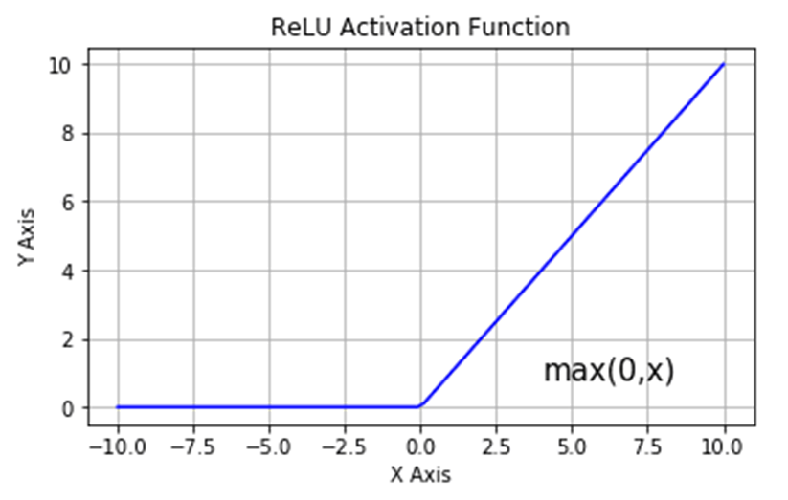
Components of VAE
Loss Function Used : MSE Loss (Mean Squared Error)
Activation Function Used : ReLU
Optimizer : Adam Optimizer
Hidden Layers : 3 to 4 Layers
Learning Rate : 0.0001

Slide 17

RESULTS AND DISCUSSIONS

Slide 18
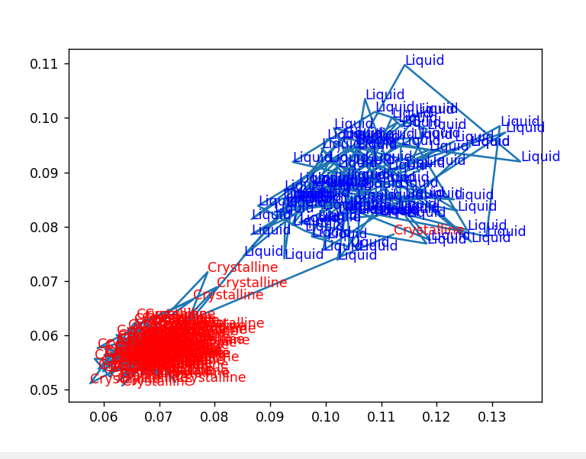
Plot obtained between 2 eigen values using PCA
OBSERVATION:
Though much distinction is observed between crystalline and liquid state but still some intermixing within the crystalline region is observed.

Slide 19
2 eigen values from PCA to 2 maximum eigen values of the Distance Matrix
INTUITION :
We observed quite intermixing with PCA compressed eigen values.
We thought that it might be possible that system is mostly driven by the 2 largest eigen values of the distance matrix.
So we switched to 2 Maximum Eigen Values.

Slide 20
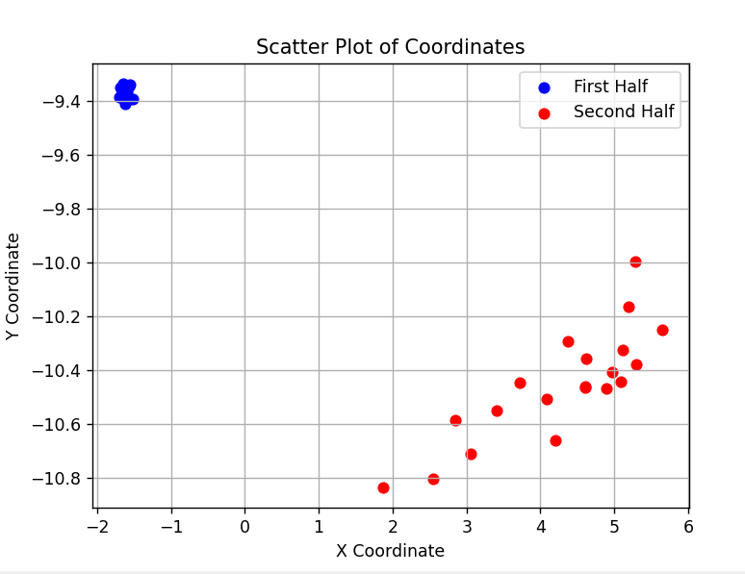
Plot obtained between 2 input eigen values of distance matrix
--- Architecture : 32x24x2
--- num of epochs =2000
Testing Loss: 223.8503

Slide 21
Why it was better than PCA compressed Eigen Values ?
OBSERVATION:
We can clearly see there is no intermixing when 2 maximum eigen values were taken as basis.
Therefore it worked as we thought.

Slide 22
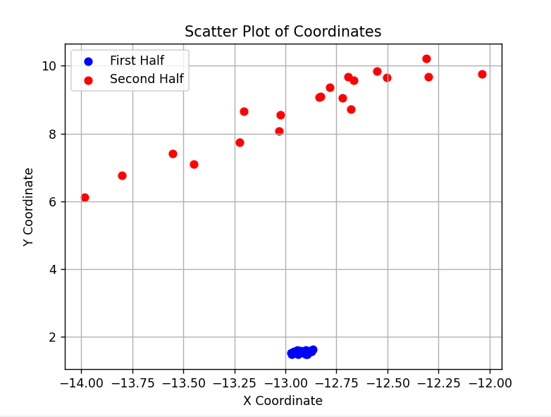
Plot obtained between 2 input eigen values of distance matrix
--- Architecture : 32x24x2
--- num of epochs =1000
Testing Loss: 294.9366

Slide 23
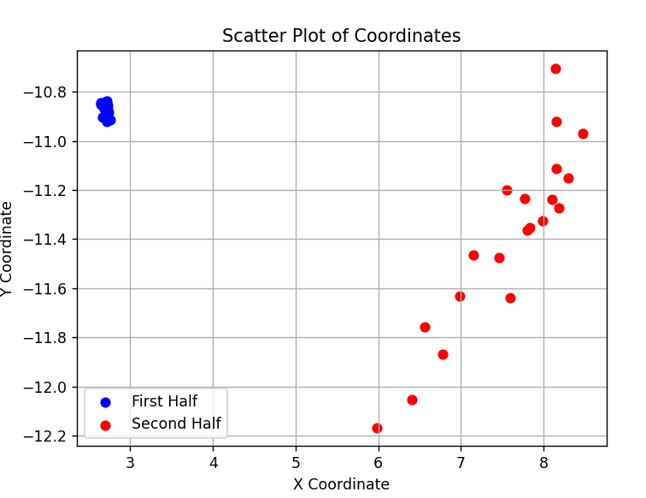
Plot obtained between 2 input eigen values of distance matrix
--- Architecture : 100x50x25x2
--- num of epochs =1000
Testing Loss: 298.9877

Slide 24
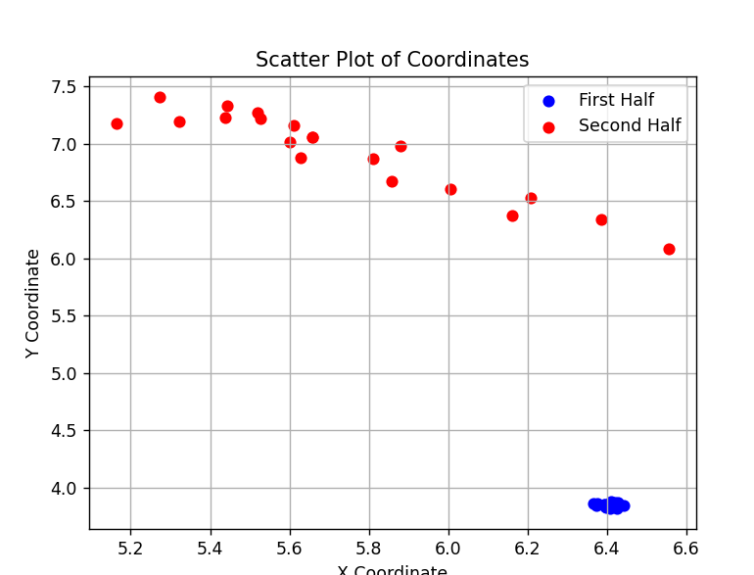
Plot obtained between 2 input eigen values of distance matrix
--- Architecture : 100x50x25x2
--- num of epochs =2000
Testing Loss: 123.0064

Slide 25
Thought : Are 2 Eigen Values Sufficient?
We took a simple compound i.e. NaCl to start with , But it maybe possible for complex compound i.e. paracetamol that system is driven by more eigen values than 2.
So we switched to 10 Eigen Values.

Slide 26
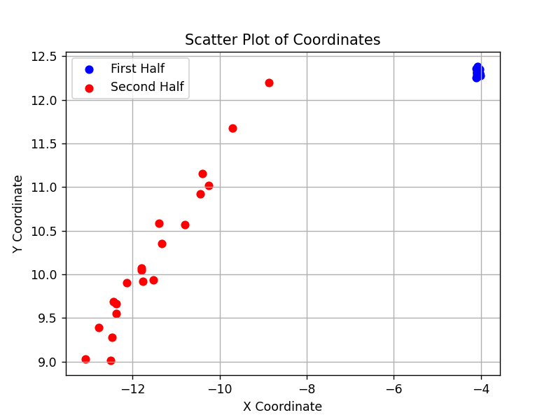
Plot obtained when taken 10 input eigen values of distance matrix
--- Architecture : 32x24x4
--- num of epochs =1000
Testing Loss: 390.0064

Slide 27
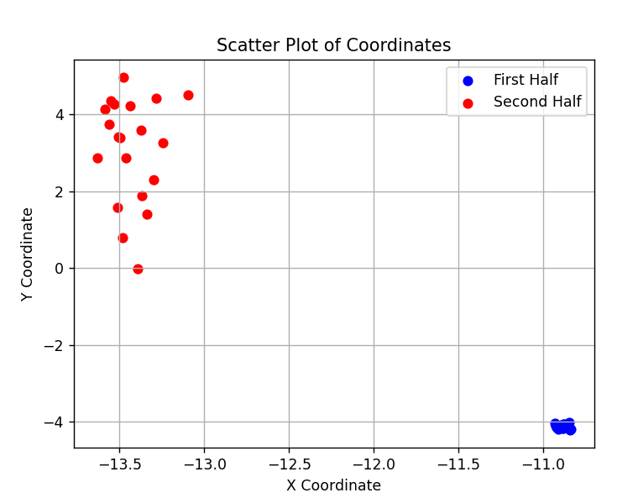
Plot obtained when taken 10 input eigen values of distance matrix
--- Architecture : 24x16x2
--- num of epochs =1000
Testing Loss: 320.044

Slide 28
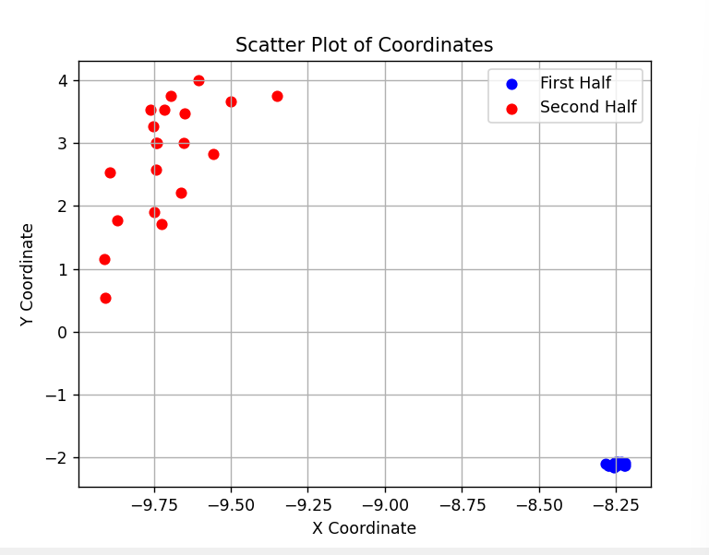
Plot obtained when taken 10 input eigen values of distance matrix
--- Architecture : 24x16x2
--- num of epochs =2000
Testing Loss: 272.4

Slide 29
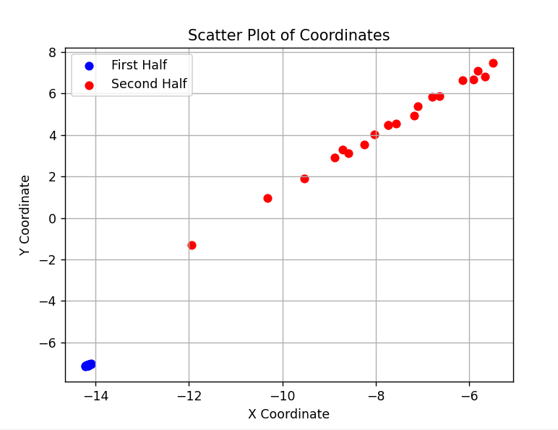
Plot obtained when taken 10 input eigen values of distance matrix
--- Architecture : 32x24x8x2
--- num of epochs =2000
Testing Loss: 584.5093

Slide 30
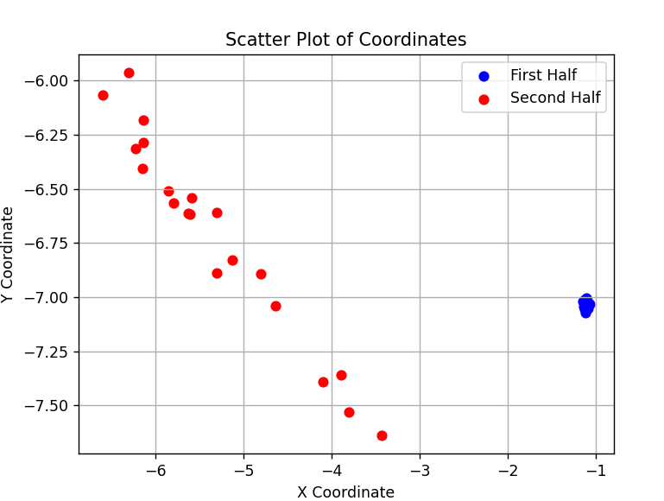
Plot obtained when taken 10 input eigen values of distance matrix
--- Architecture: 100x50x25x2
--- num of epochs =1000
Testing Loss: 203.87

Slide 31
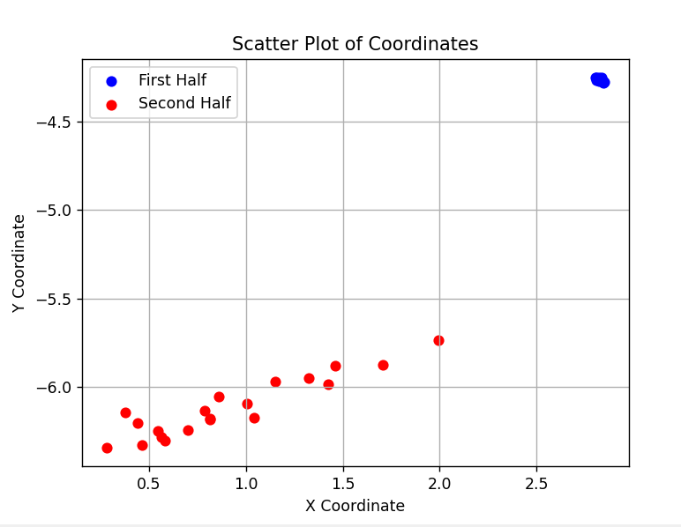
Plot obtained when taken 10 input eigen values of distance matrix
--- Architecture: 100x50x25x2
--- num of epochs =2000
Testing Loss: 211.91

Slide 32
Thought: Is Distance as parameter sufficient ?
If we talk about complex systems , it might be possible that distance is not the only dominating factor playing role in deciding what system is .
Therefore we jumped to another basic parameter i.e. Coordination Number.

Slide 33
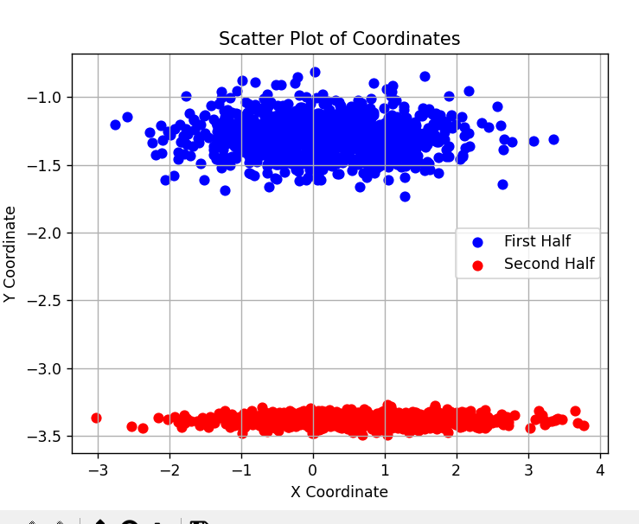
Plot obtained when taken Coordination number of each atom as input
--- Architecture: 216x108x64x8x2
--- num of epochs =200
Epoch 100/200 - Loss: 96.4697
Epoch 200/200 - Loss: 77.3156
Testing Loss: 193.5066

Slide 34
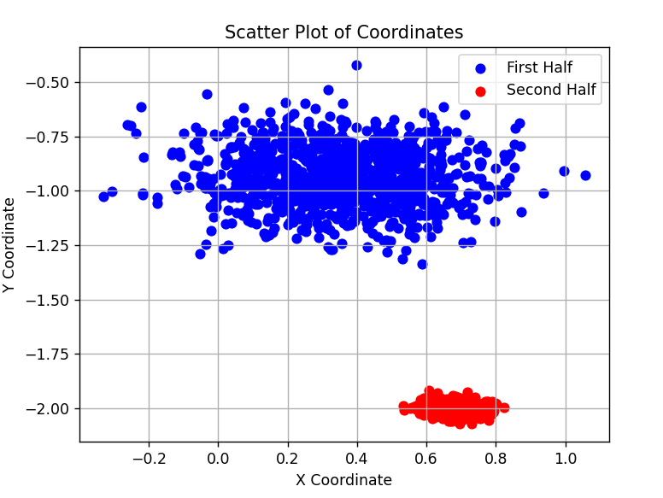
Plot obtained when taken Coordination number of each atom as input
--- Architecture: 216x108x64x8x2
--- num of epochs =500
Epoch 100/500 - Loss: 83.2711
Epoch 200/500 - Loss: 75.3095
Epoch 300/500 - Loss: 73.7035
Epoch 400/500 - Loss: 71.7807
Epoch 500/500 - Loss: 70.3254
Testing Loss: 280.2858

Slide 35
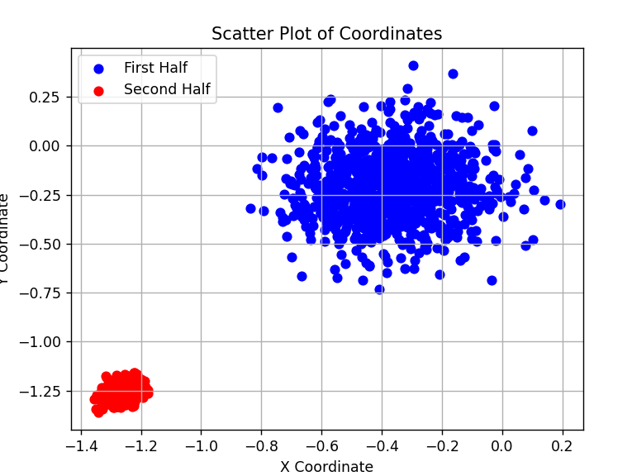
Plot obtained when taken Coordination number of each atom as input
--- Architecture: 216x108x64x8x2
--- num of epochs =1000
Epoch 700/1000 - Loss: 74.3026
Epoch 800/1000 - Loss: 74.1109
Epoch 900/1000 - Loss: 74.0362
Epoch 1000/1000 - Loss: 74.4454
Testing Loss: 287.0804

Slide 36
RESULTS AND DISCUSSIONS …
In later stages, we explored alternative collective variables like three-dimensional structure factor (SF). Simplicity guiding our quest, we found CN to be the most satisfactory collective variable.
The simulation trajectory of solid-liquid phase transitions of NaCl was analyzed.

Slide 37
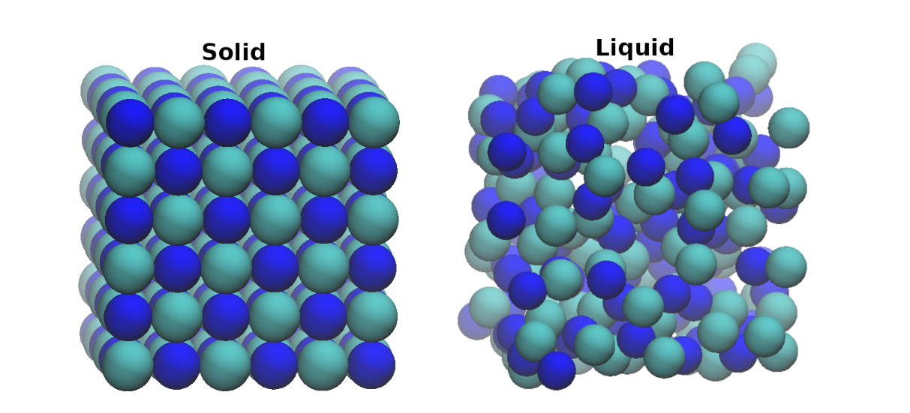
RESULTS AND DISCUSSIONS …
Solid and liquid structure of NaCl, configurations were collected from molecular dynamics simulations.

Slide 38
Conclusions
In this project, we employed machine learning based dimension reduction techniques to understand the solid-liquid phase transitions.
We have tested two approaches - first one is based on the eigenvalues obtained from the distance matrix and the second one is from the CN-based matrix. The eigenvalues thus obtained used in a VAE to obtained a two dimensional space.
Our results show that on the VAE latent space, the configurations are well-separated. These variables can satisfactorily be used as classifiers. Moreover, in our future study, we can define VAE-based collective variables for enhanced sampling simulations to study phase transitions of materials.

Slide 39
References
Collective Variables for Crystallization Simulations─from Early Developments to Recent Advances- Vikas Tiwari Soumya Mondal Nisha Kumari and Tarak Karmakar, Department of Chemistry, Indian Institute of Technology, Delhi, Hauz Khas, New Delhi110016, India https://pubs.acs.org/doi/10.1021/acsomega.2c06310
Collective Variables for the Simulation of Crystallization of Compounds: AngeloGavezzoti https://onlinelibrary.wiley.com/doi/10.1002/ijch.202100039
Collective Variables for Conformational Polymorphism in Molecular Crystals: Tarak Karmakar, Michele Invernizzi, Valerio Rizzi & Michele Parrinello https://doi.org/10.1080/00268976.2021.1893848

